Slide 1
Neural Style Transfer
Team Members:
Sumaiya Sanjana Soiree ID: 180041245
Yaya Issa Arafat ID: 180041155
Ahmed Shadab Sameen ID: 170041007
Sajid Shahriar ID: 170041026

Slide 2
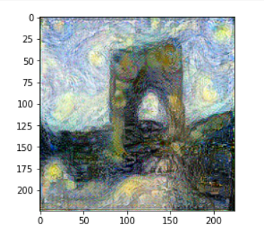
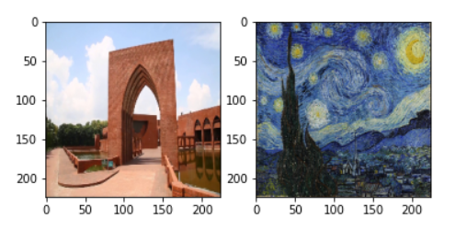
What is Neural Style Transfer?

Slide 3
Implemented Paper
A Neural Algorithm of Artistic Style
^{By Gatys et al. (2015)}
Paper Link: https://arxiv.org/pdf/1508.06576.pdf

Slide 4
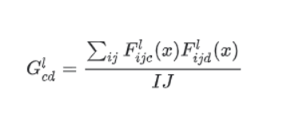
Gram Matrix
Gram Matrix depicts the correlation between two filters of the layer. It represents the measure of correlation between two filters. The gram matrix is defined as the below equation:

Slide 5
Loss Function Calculation
Loss Function Tells is the summation of style loss and content loss.
Total Loss = Style Weight * Style Loss + Content Weight * Content Loss

Slide 6
Implementation Process:
1)First we have implemented the gram matrix we have defined the gram matrix function to find the correlation between two layers
3)Then we have defined a function to load the VGG19 model.
3)Then we have loaded our style image and content image and preprocessed them using tensorflow, opencv library and plotted them using matplotlib library.
4) Then we have defined our loss function.
5)Then after that we have implemented the training step.
6) Then we have tested the Model using a photo of IUT Five Pillars as content image and Van Gogh’s Starry night as style image.

